Slide 1
Vehicle Inspection Report (DVIR)
Presented by:
<<date>>

Slide 2
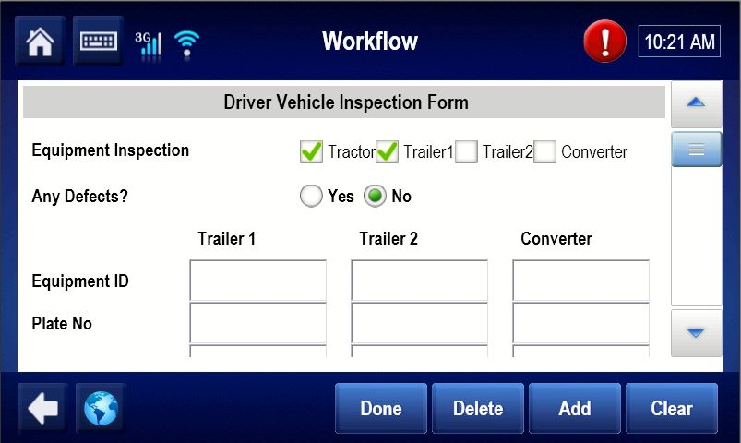
Vehicle Inspection Report
Vehicle Inspection Report provides a simple in cab process for completing vehicle and trailer inspection reports.
Saves fleets money by replacing paper vehicle inspection reports
Increases accuracy through simple prompts and error detection logic
Improves defect resolution process
Canadian compliant
2

Slide 3
Benefits of DVIR
 | Paper VIR | Electronic VIR
Time | Required to go through all submitted paperwork to find the identified defect. | Simply select defect from the drop down menu.
Management | Safety department can only address the defect when they receive the paper VIR days after detection. | Email notification of the defect is sent directly to the safety department.
Safety | Repairs can only be scheduled after the paper VIR is received. | The repair can be arranged before the truck arrives at the shop.
Storage & Filing | Difficult and ineffective to maintain paperwork for a long period. Many hours for manual data entry. | VIR maintained on the portal and easy to manage. Data can be stored for 1 year.
Cost | Full time administrative staff required to chase down paper VIR and record within the system. | Easy to maintain through the portal.
Cost | High printing and managing cost. | Eliminate costs related to printing and paper.
User Friendly | Difficult to determine the defect code. | Easy to find defect code.
Notification | No notification at all. | Real time email notifications can be sent.
Web-Portal | No website management. | Web management and easy to navigate.

Slide 4
Vehicle Inspection Report (DVIR)
No paper logs
Major defects that are fixed on the road can be updated from cab
Full web portal access to search or print all (major or minor) DVIR’s
Ability to monitor defects and schedule service
Email notifications of defects sent directly to safety department.
Data storage up to 1 year
Major & Minor defects stored on the portal
Emails sent if a Driver does not complete a DVIR
Assign WO for repairs and keep record on the portal

